Slide 1



TECHNICAL FACILITIES OF INFORMATION
Prepared & Presented by: Mirlan Nurbekov, Lecturer
Office hours: Friday 9:00–17:00
AlaToo IT & Business College
Fall 2025

Slide 2

A001
IT infrastructure design challenge

Slide 3
Title & Hook & Rules
Teams compete to design a solution
Only team leaders + representatives will see the task on screen (the rest of the team stays outside during reveal).
Lecturer will act as the customer during three customer-check cycles.
Internet access: allowed for price checks and manufacturer specs

Slide 4
Learning Objectives
Read and use hardware datasheets (IOPS, latency, throughput, endurance, cost/GB).
Design a balanced IT solution (hardware + software + backup + network) for real requirements.
Justify design decisions quantitatively and trade-off performance vs cost.
Improve communication: briefing, negotiating with a client, and presenting a technical proposal.

Slide 5

Activity Structure
Stage 1 - Teamwork training
General guidance on working as a team

Slide 6

Activity Structure
Stage 2 - Task Reveal & Planning
Only team leaders + representatives see the task
They brief their teams afterward

Slide 7

Activity Structure
Stage 3 - Work Session

Slide 8

Activity Structure
Stage 4 - Customer Q&A

Slide 9

Activity Structure
Stage 5 - Final Prep

Slide 10

Activity Structure
Stage 6 - Solution presentation

Slide 11
Teamwork Guide - 001
Team Leader: coordinates work, ensures deadlines
Representative: main communicator with client/instructor
Researchers: gather technical data, prices, and specs
Designers: prepare diagrams and structure proposal
Presenters: organize slides and final pitch

Slide 12
Teamwork Guide - 002
Communicate clearly: share updates regularly
Listen actively: respect all team member input
Distribute tasks: match jobs with strengths
Document decisions: keep a shared record of choices
Stay flexible: adapt when obstacles arise

Slide 13
Teamwork Guide - 003
Define the problem (What does the client need?)
Brainstorm options (List possible solutions)
Evaluate trade-offs (performance vs cost vs scalability)
Decide as a team (consensus or majority vote)
Test/validate idea (check datasheets, feasibility)
Prepare communication (diagram + explanation)

Slide 14

Scenario

Slide 15
Scenario
You are IT consultant company hired by a clothing retail company in Bishkek, named MirlanO.
The business has one physical store and plans to expand through e-commerce. They need a complete IT infrastructure to support the business.

Slide 16
Scenario
- Online web application (e-commerce site for clothing sales)
- Inventory management system (track stock in-store and online)
- Employee management system (attendance, payroll, scheduling)
- CCTV system management (store security monitoring & storage)
- In-store hardware (PCs, monitors, printers, POS devices, barcode scanners, keyboards, mice)
- Server & storage infrastructure (to host apps, manage data)
- Networking equipment (LAN, Wi-Fi, firewall, routers, switches)

Slide 17
Scenario
- Software stack (OS, database, ERP/CRM, backup, monitoring)
- Justified sourcing: Items must be sourced locally (Bishkek vendors) or delivered from abroad — all prices shown in Kyrgyz Soms (KGS)
- Delivery & setup timeline: Estimate shipping, installation, configuration, and when the whole system will be operational
- Scalability plan: Must support future growth (extra employees, more customers, possible second store)

Slide 18
Customer Persona
Primary needs:
Full control and management of 20 employees
Full business control including inventory/security/planning
Remote access for 2 managers
Total budget is 850 000 KGS

Slide 19
Deliverables
Hardware Proposal (server, storage, networking, peripherals)
Include monitors, keyboards, mice, UPS, routers, switches
All items must be shown with real suppliers in Bishkek or international vendors
Prices must be in Kyrgyz Soms (KGS)

Slide 20
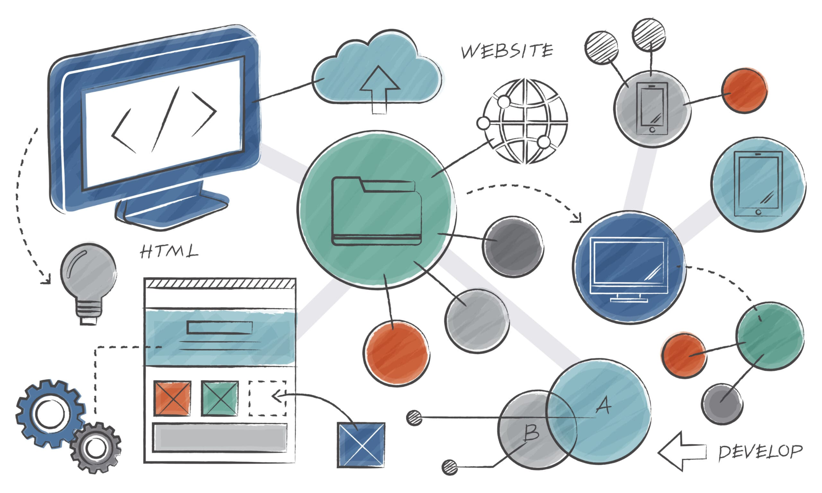
Deliverables
Software Proposal
OS
DB
Backup
Monitoring
Additional applicaitons

Slide 21

Deliverables
System Diagram (with scalability considerations)

Slide 22

Deliverables
Cost Breakdown (BOM of all items priced, total cost in KGS)

Slide 23
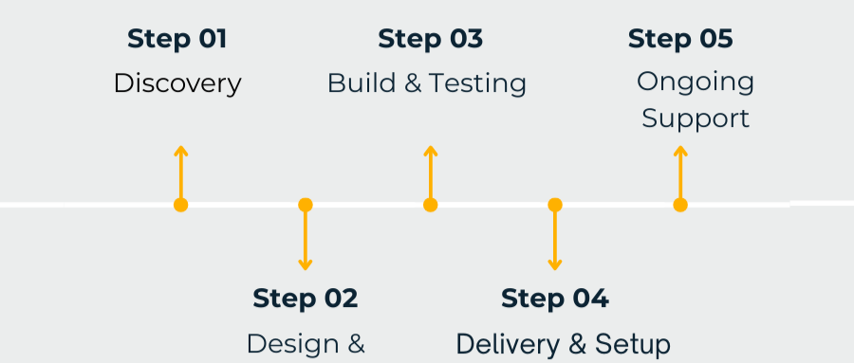
Deliverables
Delivery & Setup Timeline
How long to deliver each part?
How long to set up and configure?
When will the full system be running?

Slide 24
Deliverables
Justification for Each Choice
Why this monitor/keyboard/server/software?
If imported, why not local? Cost, quality, or features?

Slide 25
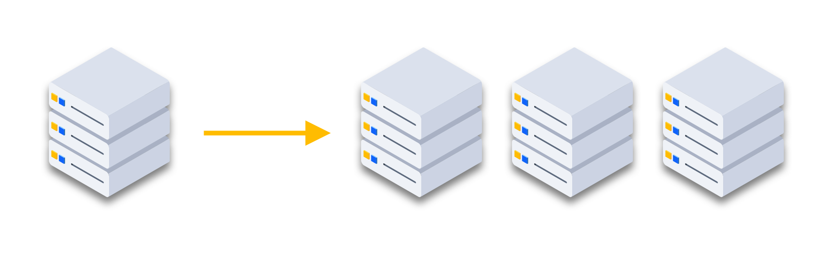
Deliverables
Scalability Plan (how the system can grow with the company)

Slide 26
Evaluation Rubric
Technical accuracy (20%)
Cost justification in KGS (20%)
Delivery & setup timeline (15%)
Scalability & future-proofing (15%)
Clarity of system diagram (15%)
Presentation quality (15%)

